Slide 1
Chapter 7: Vectors and the Geometry of Space
Section 7.6
Surfaces in Space
Written by Richard Gill
Associate Professor of Mathematics
Tidewater Community College, Norfolk Campus, Norfolk, VA
With Assistance from a VCCS LearningWare Grant

Slide 2
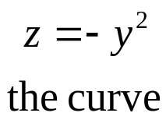
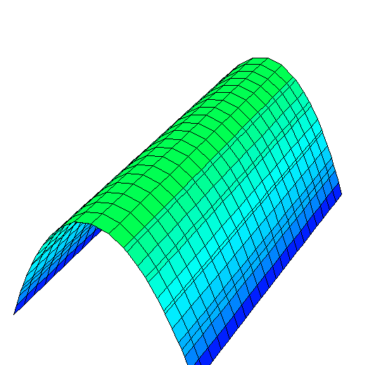
In this lesson we will turn our attention to two types of 3-D surfaces: Cylinders and Quadric Surfaces.
Let C be a curve in a plane and let L be a line not parallel to that plane. Then the set of points on lines parallel to L that intersect C is called a cylinder. The straight lines that make up the cylinder are called the rulings of the cylinder.
z
In the sketch, we have the generating curve, a parabola in the yz-plane:
The line L is the x-axis.
y
The rulings are parallel to the x-axis.
rulings
x

Slide 3

Consider the cylinder generated by the equation
For a point on this surface, the x-coordinate can take on any value as long as the y- and z-coordinates satisfy the equation
z
Cross-section of the surface in the yz-plane.
An effective way to visualize this surface is to move about 5 units down the x-axis and place a copy of the circle in its corresponding position.
y
Then draw lines parallel to the x-axis (rulings) that connect corresponding points on the two circles and you have a pretty good idea what the cylinder looks like.
x

Slide 4

Consider the cylinder generated by the equation
For a point on this surface, the x-coordinate can take on any value as long as the y- and z-coordinates satisfy the equation
z
An effective way to visualize this surface is to move about 5 units down the x-axis and place a copy of the circle in its corresponding position.
y
Then draw lines parallel to the x-axis (rulings) that connect corresponding points on the two circles and you have a pretty good idea what the cylinder looks like.
x

Slide 5
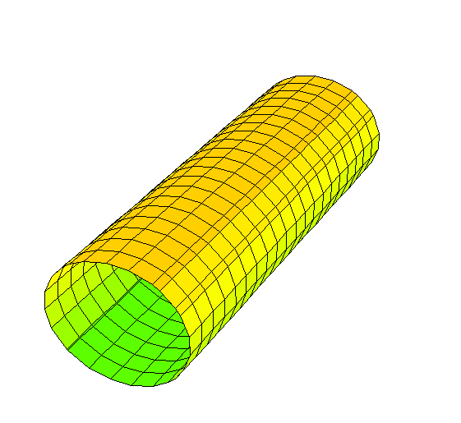
Here is a more sophisticated version done on DPGraph. Please go to www.dpgraph.com and click on List of Site Licenses. Find TCC in the listed schools and download this free program now. Most of the graphs in this lesson are done on DPGraph.
z
y
The bad news about DPGraph is that it uses a left-handed system. You can often convert to a right-handed system if you swap the x and y terms in your equation. More on that later.
x

Slide 6
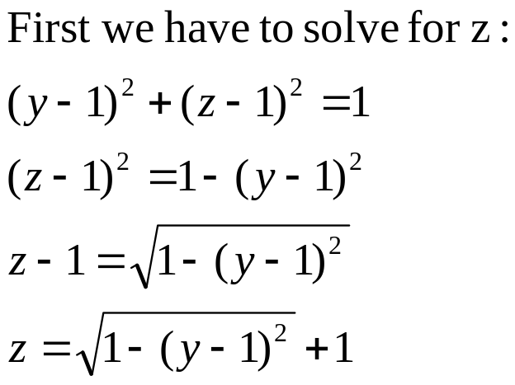
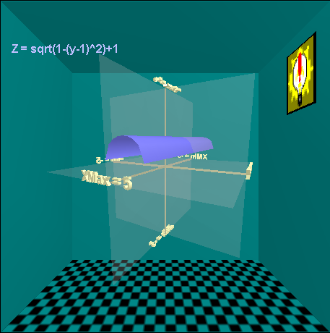
Bright Ideas Software has a very cool and very free 3D Surface Viewer. To construct your own copy of the half-cylinder that you see below, go to
http://www.brightideassoftware.com/DrawSurfaces.asp
and enter the equation for the top half of the surface in the previous slide.
If you want to see the bottom half of the cylinder, slap a negative in front of the square root. You can click on the image and turn it to see the image from different perspectives. Add this link to your favorites list in your browser and call it the 3D Grapher.

Slide 7

Limitations: you cannot enter equations implicitly. Every surface has to be generated by a function with z as the dependent variable. You can only enter one function at a time so we cannot view the top half and the bottom half simultaneously.
Still, this is a decent piece of graphing software. Feel free to make your own graphs as needed during the lesson.

Slide 8
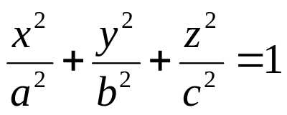
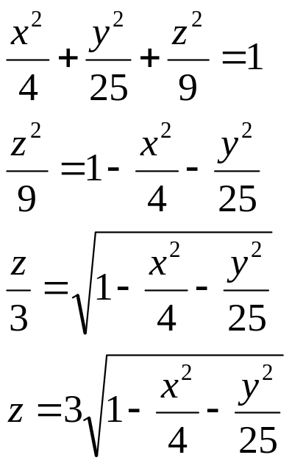
We now move from cylinders to Quadric Surfaces. A quadric surface in space is generated by a second-degree equation of the form:
In this lesson, we will be working with equations where G=H=I=0.
The first quadric surface we examine will be the Ellipsoid. A football is an ellipsoid. Planet Earth is also an ellipsoid. The standard form of an ellipsoid is:
The graph of this equation is the top half of the ellipsoid. Convert the 3 to -3 to see the bottom half. Link to the 3D Grapher and graph both the bottom and top.
If a=b=c, then the ellipsoid is a sphere.
To graph an ellipsoid in standard form, we may have to solve for z. Consider:

Slide 9
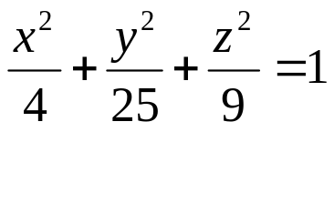
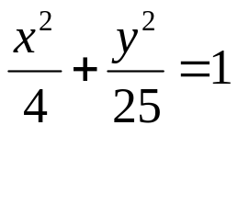
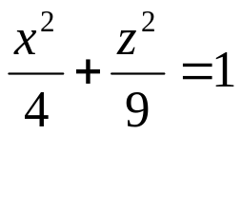
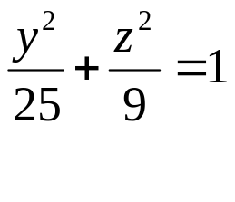
It is very helpful to examine the intersection of the quadric surface with the coordinate planes or even with planes that are parallel to the coordinate planes. Consider the table below for the ellipsoid of the previous slide:
Plane
Equation
Trace
Check out the graph on the next slide! The graph was done on DP Grapher but the x and y terms had to be reversed since DP Grapher uses a left-handed system. The remaining graphs in this lesson will be done on DP Grapher.
xy-plane
(z=0)
Ellipse
xz-plane
(y=0)
Ellipse
yz-plane
(x=0)
Ellipse

Slide 10
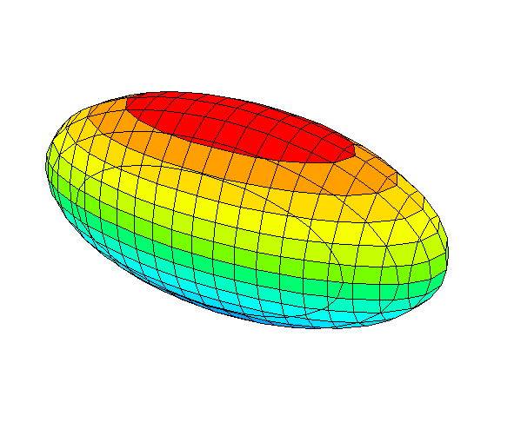
The trace in the yz-plane is the ellipse:
z
The trace in the xz-plane is the ellipse:
The trace in the xy-plane is the ellipse:
y
x

Slide 11
Most of the graphs that you can link to below have been done on Mathematica, which is very expensive, but can create impressive graphs. Click on the graphs and twist them to get a better perspective.
Hyperbolic paraboloid: http://mathworld.wolfram.com/HyperbolicParaboloid.html
Cone: http://mathworld.wolfram.com/Cone.html
Elliptic Cylinder: http://mathworld.wolfram.com/EllipticCylinder.html
Hyperboloids: http://mathworld.wolfram.com/Hyperboloid.html
Sphere: http://mathworld.wolfram.com/Sphere.html
Paraboloid: http://mathworld.wolfram.com/Paraboloid.html
Ellipsoid: http://mathworld.wolfram.com/Ellipsoid.html

Slide 12
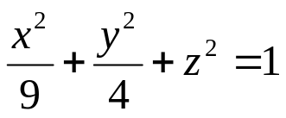
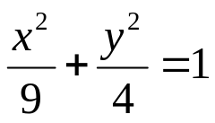
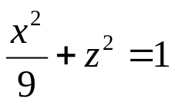
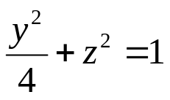
Example 1: Fill in the trace table for the following equation.
Answer each question on your own before you click to the answer.
What is the equation and the trace of the intersection in the xy-plane?
Plane
Equation
Trace
What is the equation and the trace of the intersection in the xz-plane?
xy-plane
(z=0)
Ellipse
xz-plane
(y=0)
Ellipse
What is the equation and the trace of the intersection in the xz-plane?
yz-plane
(x=0)
Ellipse

Slide 13
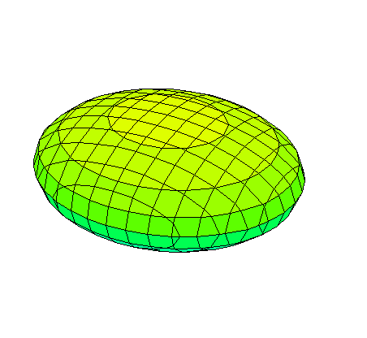
Can you find the trace in the xz plane?
Notice in each case that the intersection of the graph and the coordinate plane is an ellipse.
Can you find the trace in the yz plane?
z
y
Can you find the trace in the xy plane?
x

Slide 14
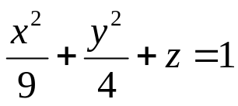
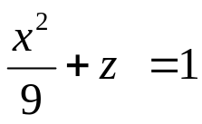
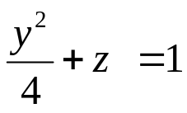
Our next surface is the paraboloid. Two traces will be parabolas and the third will be an ellipse.
Example 2: Fill in the trace table for the following equation.
Answer each question on your own before you click to the answer.
What is the equation and the trace of the intersection in the xy-plane?
Plane
Equation
Trace
What is the equation and the trace of the intersection in the xz-plane?
xy-plane
(z=0)
Ellipse
What is the equation and the trace of the intersection in the xz-plane?
xz-plane
(y=0)
Parabola
A paraboloid generates a trace of an ellipse in planes parallel to one coordinate plane. It generates traces of a parabola in planes parallel to the other two coordinate planes.
yz-plane
(x=0)
Parabola

Slide 15
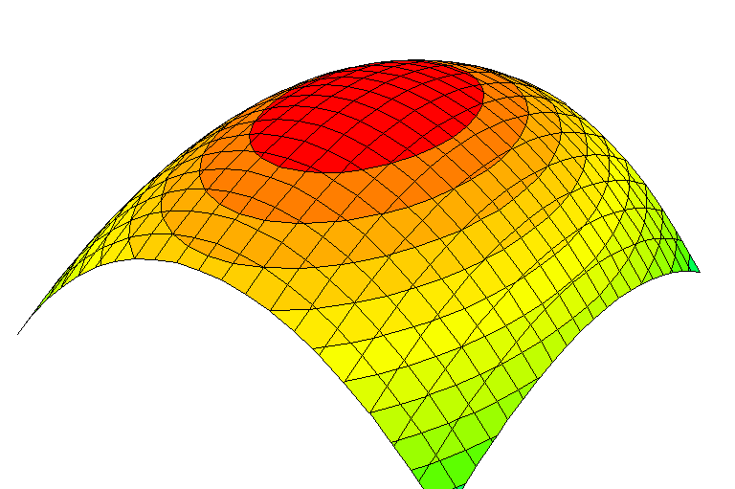
Can you find the ellipse in the xy-plane?
z
Can you find the parabola in the xz-plane?
Can you find the parabola in the yz-plane?
y
x

Slide 17
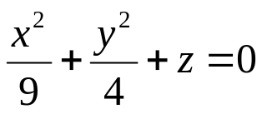
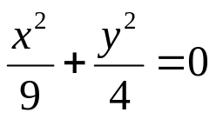
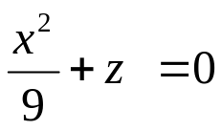
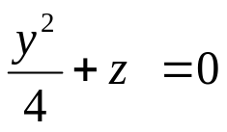
Example 3: Fill in the trace table for the following slightly different equation.
Answer each question on your own before you click to the answer.
What is the equation and the trace of the intersection in the xy-plane?
Plane
Equation
Trace
xy-plane
(z=0)
Origin: x=y=z=0
What is the equation and the trace of the intersection in the xz-plane?
xz-plane
(y=0)
Parabola
What is the equation and the trace of the intersection in the xz-plane?
yz-plane
(x=0)
Parabola
When one of your coordinate planes comes up empty or has a trace of just the point (0,0,0), look at the trace of planes parallel to the coordinate plane. For example try z=3 or z=-3.
If z=3 there is no trace since three positive numbers cannot add to be 0.

Slide 18
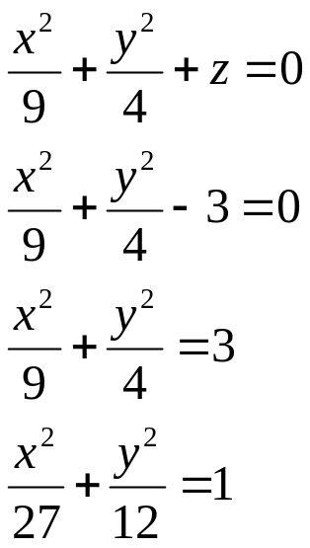

But if z=-3 then your trace is an ellipse and your equation is:
z
y
x
Every point on this ellipse has a z-coordinate of -3.

Slide 19
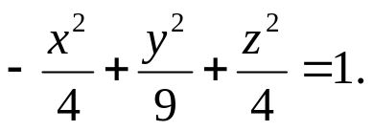
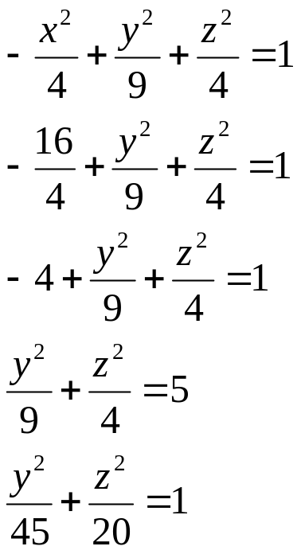
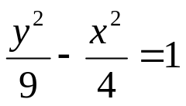
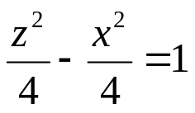

Our next surface will be the hyperboloid. We will look at two types: the hyperboloid of one sheet and the hyperboloid of two sheets. In each case, two traces will be hyperbolas and the third trace will be an ellipse.
Example 4. Fill in the table below for
Try to fill in each entry on your own before you click.
When drawing a hyperboloid of one sheet on your own, it is usually helpful to draw the ellipse in the coordinate plane and two parallel ellipses equidistant from the coordinate plane. For example, at x=4, x=-4:
Plane
Equation
Trace
xy-plane
(z=0)
Hyperbola
xz-plane
(y=0)
Hyperbola
yz-plane
(x=0)
Ellipse

Slide 20
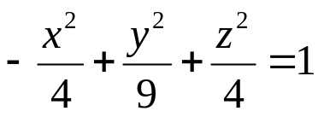
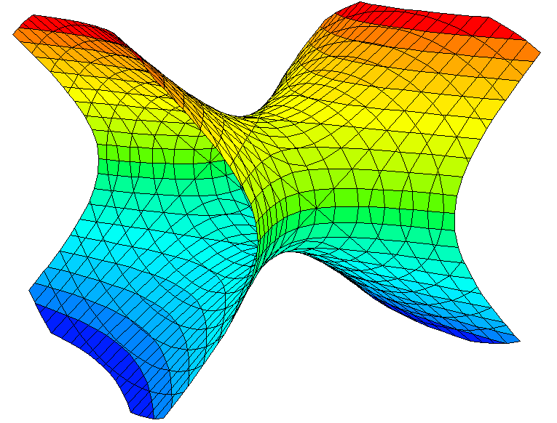
z
x
y
The ellipse at x=-4.
The ellipse at x=0.
The ellipse at x=4.

Slide 21
One branch of hyperbola at y=0.
z
The other branch of the hyperbola at y=0.
x
y
One branch of the hyperbola at z=0.
Other branch of hyperbola at z=0.

Slide 22
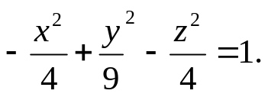
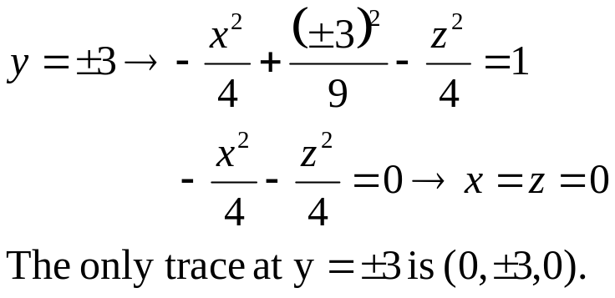
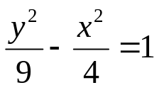
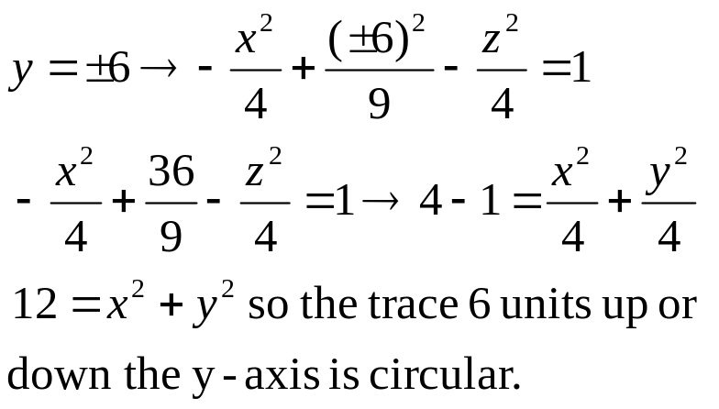
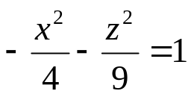

While the hyperboloid of one sheet is a single surface, the hyperboloid of two sheets comes in two pieces.
Example 5. Fill in the table below for
Plane
Equation
Trace
xy-plane
(z=0)
Hyperbola
xz-plane
(y=0)
Empty
yz-plane
(x=0)
Hyperbola
At y=0, the xz-plane is empty. It is important to look at other values of y. At y=3 and at y=-3, we find the vertices of the hyperbola. At y=6 and at y=-6, we get a good look at the circular cross sections.

Slide 23
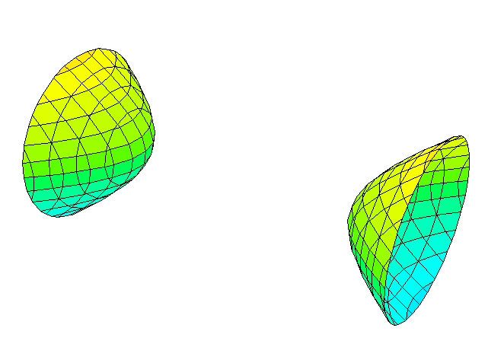
Hyperbola at x=0.
z
y
x
Circular traces at y=-6 and at y=6.

Slide 24
z
y
x
Hyperbola at z=0.
Other branch at z=0.

Slide 25
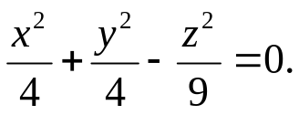
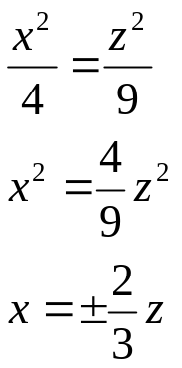
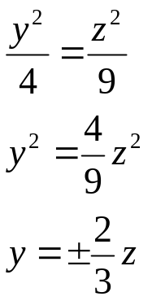
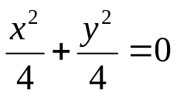
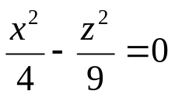
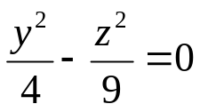
Our next surface is a familiar structure, the elliptic cone. When centered at the origin, traces in two coordinate planes are intersecting lines, but traces parallel to these coordinate planes are hyperbolas.
Example 6. Fill in the table below for
Plane
Equation
Trace
xy-plane
(z=0)
(0,0,0)
xz-plane
(y=0)
Two lines
I didn’t think so. When your traces give you bare bones information like this, you need to look at planes that are parallel to the coordinate planes.
yz-plane
(x=0)
Two lines
So it’s all pretty clear now isn’t it?

Slide 26
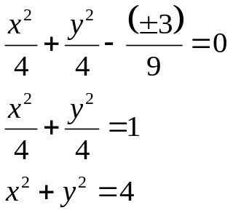

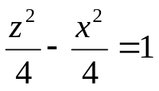
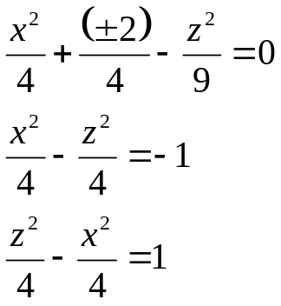
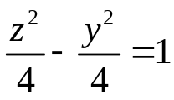
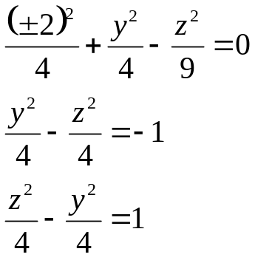
Example 6, Part 2. Fill in the table below for
Planes parallel to…
Equation
Trace
xy-plane
(z=3, z=-3)
Circles
xz-plane
(y=2, y=-2)
Hyperbolas
yz-plane
(x=2, x=-2)
Hyperbolas
There is much more information here than in the previous slide. There are circular cross sections as you move up and down the z-axis, and hyperbolic cross sections in planes parallel to the xz-plane and to the yz-plane.

Slide 27
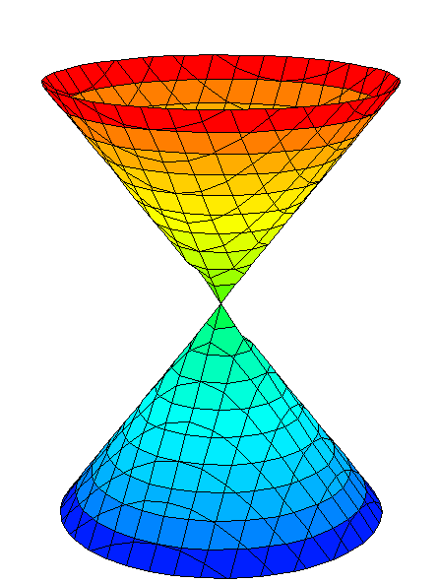
z
Hyperbolic trace at x=2
The hyperbolic trace at x=-2 is on the back side of the surface.
y
y
x
Circular traces at z=3 and at z=-3

Slide 28
z
The straight line traces at x=0 and the hypberbolic trace at y=-2 are on the back side.
Hyperbolic trace at y=2
Straight line traces at y=0
y
y
x

Slide 29








The last quadric surface in this lesson is the hypberbolic paraboloid. The
standard equation is with the major axis denoted by the variable
to the power of 1. The traces parallel to two coordinate planes will be hyperbolas. Planes parallel to the third coordinate plane will have hyperbolic traces.
Example 7. Fill in the table below for:
Plane
Equation
Trace
As in previous examples it is often a good idea to look at planes parallel to a coordinate plane to get more information.
xy-plane
(z=0)
Straight lines
xz-plane
(y=0)
Parabola
yz-plane
(x=0)
Parabola

Slide 30

Parabolic trace at y=0
Straight line traces at z=0
z
y
x

Slide 31

Parabolic trace at x=0
z
y
Hyperbolic trace at z=1
x

Slide 32






A Summary of Quadric Surfaces
Type | Equation | Traces
Ellipsoid
Traces parallel to the coordinate planes are ellipses. Surface is a sphere if a = b = c.
Elliptic Paraboloid
For z > 0, traces are ellipses. Planes parallel to the xz- and yz planes are parabolas.
Hyperboloid of One Sheet
Traces parallel to the xy-plane are ellipses. Traces parallel to the xz- and yz-planes are hyperbolas.
Hyperboloid of Two Sheets
Traces parallel to the xy-plane are ellipses. Traces parallel to the xz- and yz-planes are hyperbolas.
Elliptic Cone
Traces parallel to the xy-plane are ellipses. Traces parallel to the xz- and yz-planes are hyperbolas.
Hyperbolic Paraboloid
Traces parallel to the xy-plane are hyperbolas. Traces parallel to the xz- and yz-planes: parabolas.
For the ellipsoid the z-axis is the major axis if c > a and c > b. The other surfaces in the table use the z-axis as the major axis. Adjustments to the equations can create surfaces with the y-axis or the x-axis as the major axis.

Slide 33

Example 8. Match the equation with the appropriate graph type.
___ Hyperbolic Paraboloid
___ Elliptic Cone
___ Cylinder
___ Hyperboloid of One Sheet
Solution. Starting with equation a, what do you think?
Equation a is the generating curve for the cylinder. The generating lines will be parallel to the y-axis. Go to Slide 2 for a review on cylinders.
Equation b generates a hyperolic paraboloid. Go to slide 29 for a review.
Equation c generates a hyperboloid of one sheet. Go to slide 19 for review.
Equation d generates an elliptic cone. Go to slide 25 for a review.

Slide 34


Example 9. Choose the statement that is most appropriate to the equation:
The trace in the yz-plane is empty.
The trace in planes parallel to the yz-plane is an ellipse.
The trace in the xz-plane is a hyperbola.
All of the above.
Solution. The answer is d. Go to slide 22 to review hyperboloid of two sheets.
Example 10. Choose the statement that is most appropriate to the equation:
The trace in the xy-plane is a parabola.
The trace in the xz-plane is an ellipse.
The trace in the yz-plane is empty.
All of the above.
Solution. The answer is b. Go to slide 9 for a review on ellipsoids.

Slide 35




Example 11. Match the equation to the appropriate graph.
z
z
a
d
x
y
x
z
y
z
b
y
x
y
x
c

Slide 36

This is the end of Lesson 7.6. There are three sets of exercises in our Blackboard site. As usual, you can work one set or all three. Each problem answered correctly generates another exercise toward your thinkwell exercise total.

